Slide 1
1st report for the hackathon
Name- Samyak jain
Code – GSBSP-BR-43

Slide 2
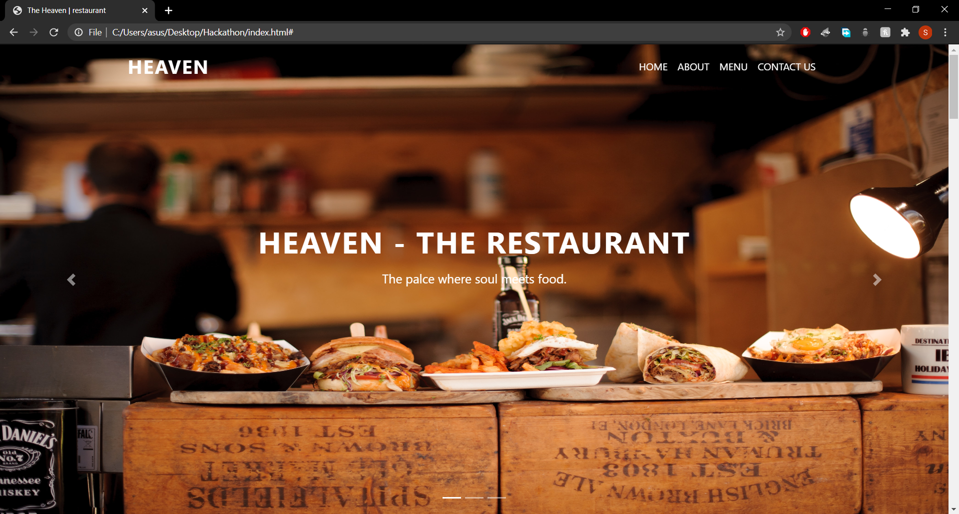
The landing page of my website named as HEAVEN.I have used bootstrap for navigation bar and carousel.

Slide 3
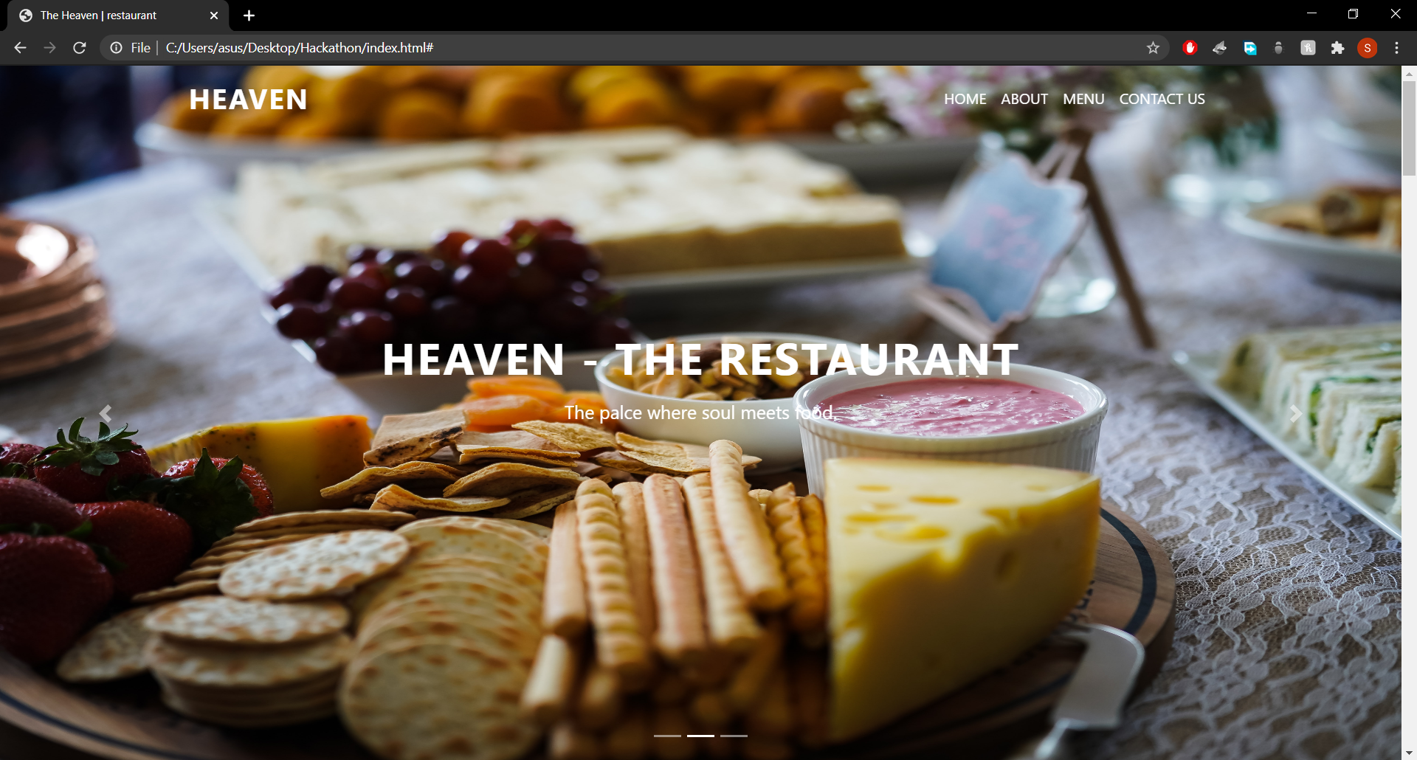
All the images are taken from unsplash.com and pintrest which are free and open source for the commertial use.

Slide 4
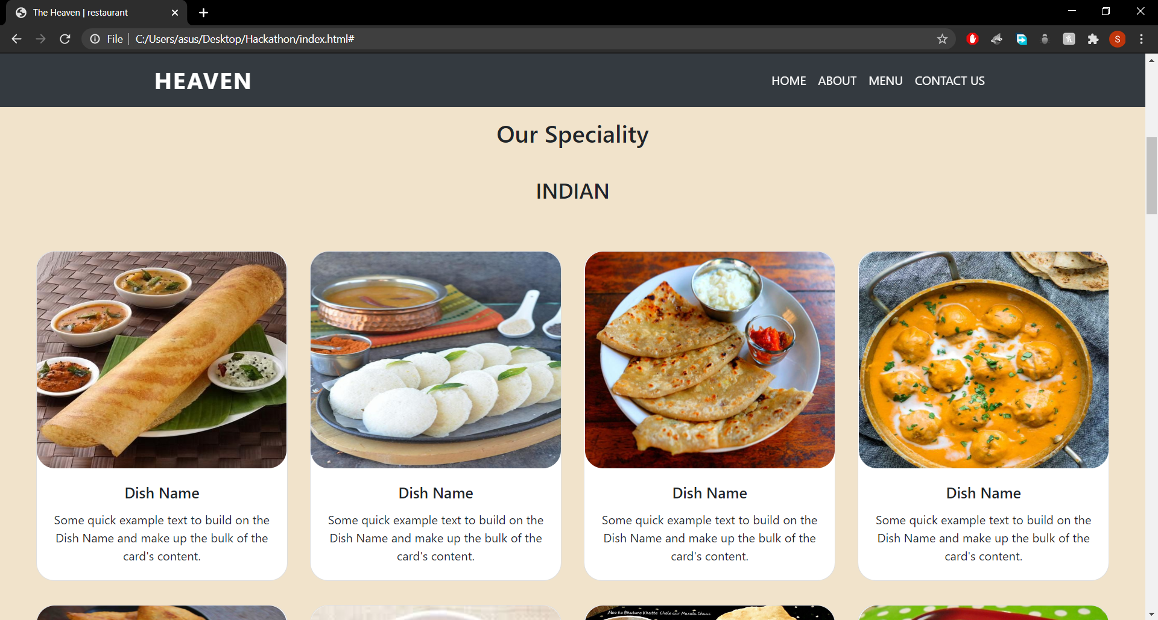
I have added menu bar as per the problem statement with 30 dishes(different catagories). I am working on it right now…I will add fonts and styles and price of the dishes soon.

Slide 5
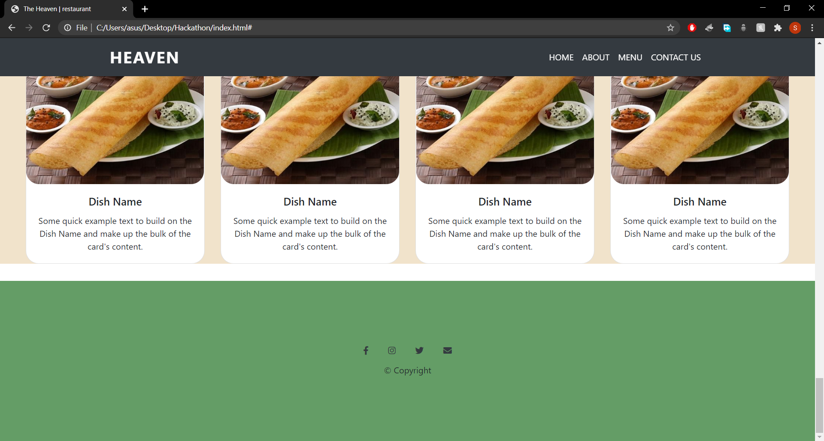
This is the footer section as mentioned in problem statement and I used icons so that user can contact us on different social media platforms. I used fontawesome.com for the icons which gives free icons for use.

Slide 6
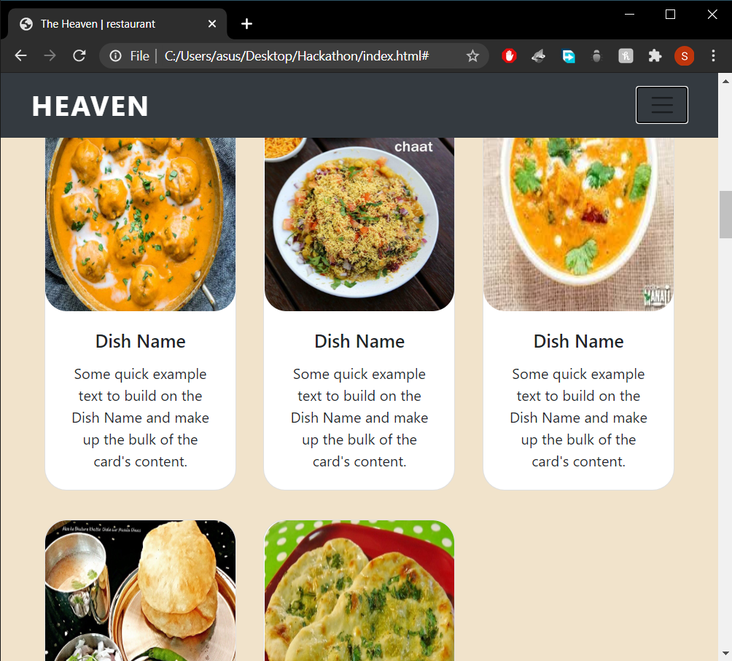
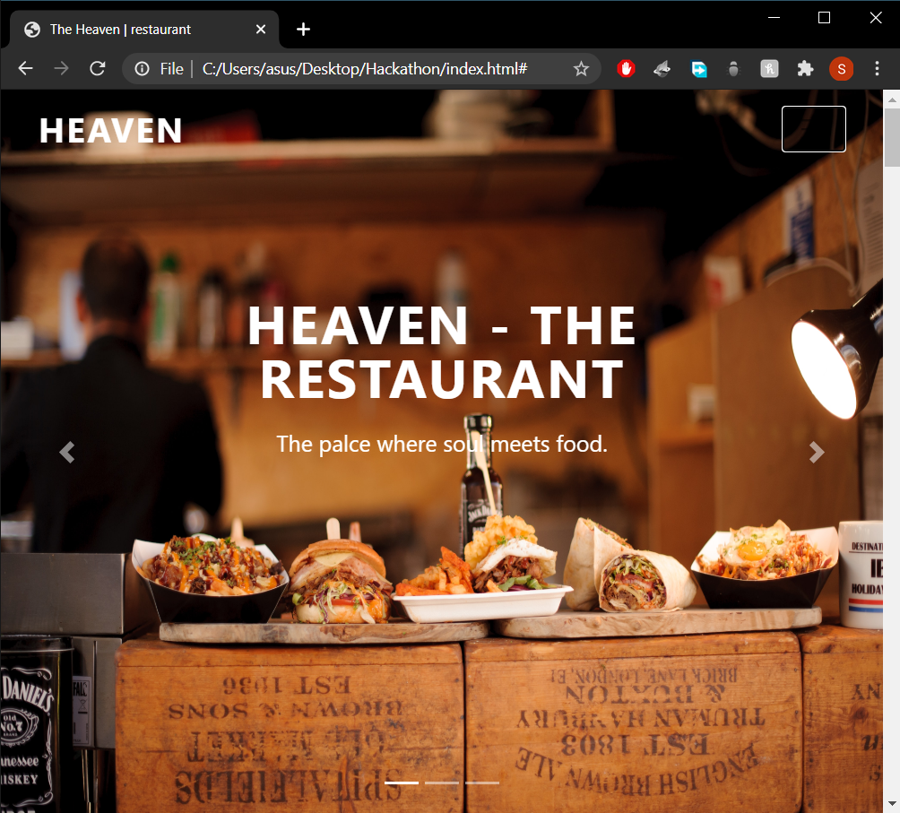
Responsive website

Slide 7
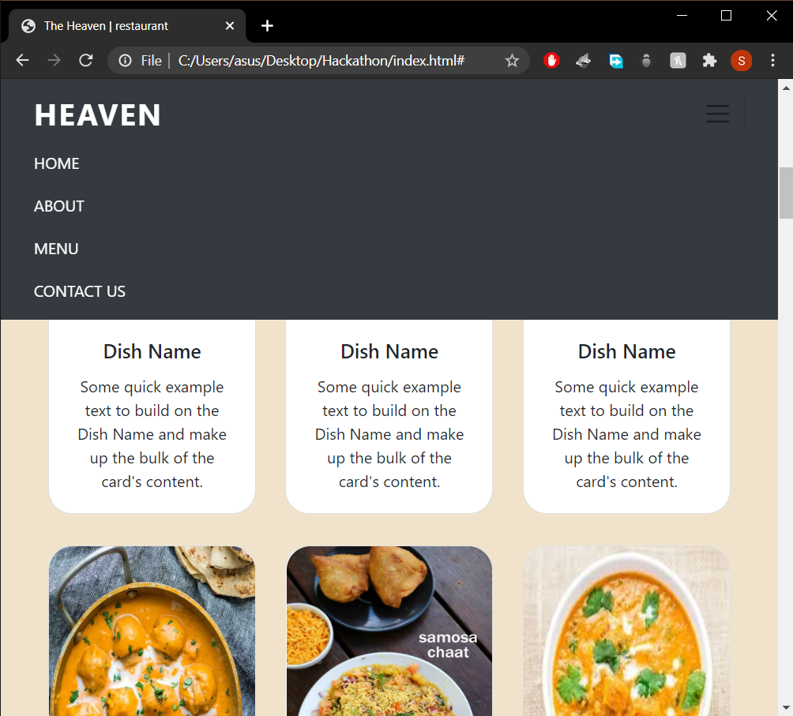
Responsive - NavBar

Slide 8
Till now I have created a template for the restauraunt. Where the nav-bar is working perfectly and links are redirecting us to different sections of page and page is fully responsive. I will add some fonts designs, logo on the website soon may be in next 12 hours. I will change the colors of the different section so that it will look more attractive.

Slide 9
If there is anything that needed to be change please tell…I will change it as soon as possible. Thankyou!!

